Slide 1


Your VSP
Vision Benefits
Members First,
Members for Life
INTERGOVERNMENTAL PERSONNEL BENEFIT COOPERATIVE – VILLAGE OF BLOOMINGDALE
Effective JULY 1, 2020
[Company Logo Here]
Notes:
SLIDE INSTRUCTIONS:
Use this slide for co-branded presentations. Add your client’s name, logo, the effective plan date, and open enrollment dates.
Please only use one intro slide
Intro Slide Option #1 Script
Thank you for taking the time to learn more about the vision benefits [client’s name] is offering you in partnership with VSP Vision Care.
Optional Script for OE time period:
Thank you for taking the time to learn more about the vision benefits [client’s name] is offering you in partnership with VSP Vision Care. As a reminder, your Open Enrollment dates are xx/xx – xx/xx/xx

Slide 2
INTERGOVERNMENTAL PERSONNEL BENEFIT COOPERATIVE
Intergovernmental Personnel Benefit Cooperative – Village of Bloomingdale
IPBC Plan C
Frame Allowance $150
Featured Frame Brand +$20
Contact Lens Allowance $150
Only prescription lenses/frames
Notes:
SLIDE INSTRUCTIONS:
Delete this slide if your client offers only one VSP vision plan.
Add Client’s name and plan names
Script:
[Client’s name] is offering two vision plans for you to choose from – The VSP [client’s Base plan name] and the VSP [client’s Buy-Up plan name]. Both plans offer comprehensive benefits [every 12 months]. Now let’s take a look at both plans so you can select the right one for you.

Slide 3
VSP Plan at a glance
 | Intergovernmental Personnel Benefit Cooperative Plan C
Exam | WellVision Exam covered every 12 months $0 Copay
Frame Allowance | $150 Frame allowance every 12 months $0 copay
Lenses (every 12 months) | Single vision, lined bifocal or lined trifocal lenses for adults. Single vision, lined bifocal or lined trifocal polycarbonate lenses for children.
Lens Enhancements | Standard Progressive lenses covered with $0 copay Photochromics/Tints/Dyes covered in full 20-25% savings on lens enhancements–Scratch-resistant, UV, Anti-reflective coating
Contact Lens Allowance (in lieu of glasses) | $150 allowance for contacts lenses and copay up to $60 for contacts lens exam (fitting and evaluation)
Diabetic Eyecare Plus Program | Services related to diabetic eye disease glaucoma, and age-related macular degeneration. $20 Copay
Retinal Screening | No more than a $39 copay on routine retinal screening as an enhancement to a WellVision Exam.
Your Monthly Contribution | $10.62 Member only, $21.24 Member + 1, $22.72 Member + Dependent Child(ren) $36.32 Member + family
Notes:
SLIDE INSTRUCTIONS:
Delete this slide if your client offers two VSP vision plans.
Add Client’s plan names, copays, frame allowances, lens enhancement savings, contact lens allowances, and monthly contributions.
Script:
When you choose a VSP vision plan, you will receive great savings when you visit a VSP network doctor.
A WellVision Exam is covered in full every 12 months with a $XX copay
Prescription lenses are covered every [12 months].
Your plan includes a frame allowance of [$XX every other] calendar year.
Fully covered single vision, lined bifocal or lined trifocal lenses for adults, as well as fully covered single vision, lined bifocal or lined trifocal polycarbonate lenses for children with a [$XX copay].
Your plan will also offer savings of [XX-XX%] on lens enhancements such as Scratch-resistant, UV or Anti-reflective coatings
Or, you can choose contacts instead of glasses with a [$XX] contact lens allowance with a copay of up to [$XX] for the contact lens exam.
[if applicable: Diabetic Eyecare Plus Program: Services related to diabetic eye disease glaucoma, and age-related macular degeneration. $XX Copay]
[if applicable: And new for 2019, a yearly Retinal imaging exam that helps detect signs of eye disease is covered for a low $XX copay]
Your monthly contribution for your plan is [$XX member only, $XX member + 1, or $XX member + family]

Slide 4

WHY CHOOSE VSP?
The only national
not-for-profit vision
insurance company¹
Quality care.
64 years of helping people
see well and stay healthy
More choices.
Nationwide network of
more than 38,000 providers
88 million
members nationwide
Providing no-cost eye care through Eyes of Hope®
Great value!
VSP® is consumers’ #1
choice In vision care²
1. VSP insurance plans have exclusions and limitations. For costs and complete details of the coverage, contact VSP at 800.877.7195.
2. National Vision Plan Member Study, 2017.
Notes:
Script:
As the only national not-for-profit vision insurance company, VSP is committed to our members wellness over profit. We have 64 years of helping people see well and stay healthy. Our Eyes of Hope® charitable program provides no-cost eye care and eyewear for more than 2 million adults and children in need. With 88 million members worldwide, it’s easy to see why VSP is consumers’ #1 choice in vision care.

Slide 5







The right network
INDEPENDENT DOCTORS
PREMIER PROGRAM
ONLINE RETAIL
CUSTOMIZED RETAIL OPTIONS, INCLUDING
98K In-Network Choices

Slide 6
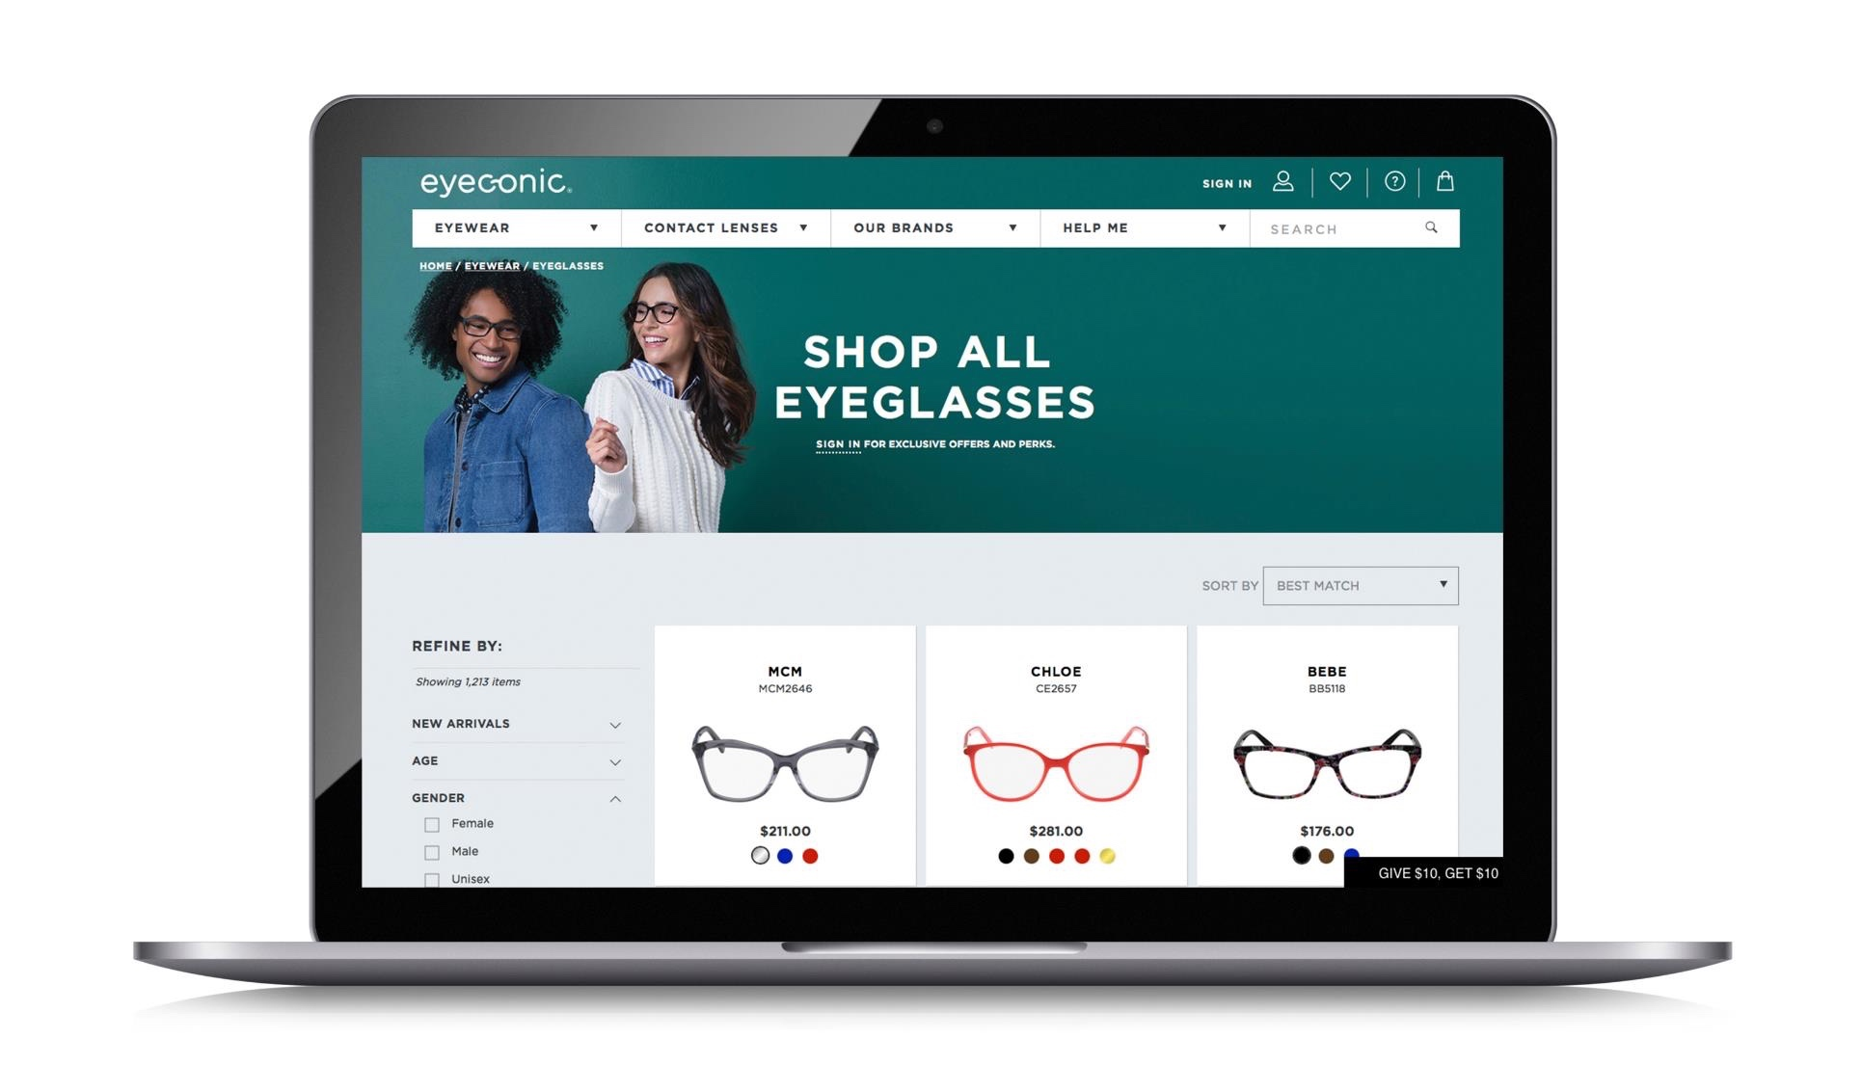

Eyeconic.com
Eyeconic is the only place where
VSP members can shop online for contacts and eyewear with their
VSP insurance in-network.
Personalized: As a VSP-owned company, Eyeconic seamlessly connects VSP vision benefits to your account.
Simple: Save time and money on quality eyewear with a few easy clicks.
Connect your vision insurance.
Select your product.
Upload your prescription or provide your doctors contact information and we’ll take care of the rest.
Choice: Eyeconic offers a variety of well-known brands and contact lenses. Choose from over 35 eyewear brands and over 1600 styles.
Notes:
Script:
Eyeconic is the only place where VSP members can shop online for contacts and eyewear with their VSP insurance in-network.
As a VSP-owned company, Eyeconic seamlessly connects VSP vision benefits to a members’ account. By applying vision benefits, they see savings in real time.
Save time and money on quality eyewear with a few easy clicks.
1. Connect your vision insurance
2. Select your product
3. Upload your prescription or provide your doctors contact information and we’ll take care of the rest.
Eyeconic offers a variety of well-known name brands and contact lenses. Choose from over 35 eyewear brands and over 1600 styles.

Slide 7





Exclusive Member Extras
Big Value. More Saving with VSP Vision Care.
With Exclusive Member Extras, savings never looked so good. VSP puts members first by providing you with exclusive special offers from leading industry brands, totaling more than $3,000 in savings. Discover great deals on glasses, sunglasses, contact lenses, and more.
Special Deal on Glasses—
Extra $20 on Featured Frame Brands
Save 25-40% on popular lens enhancements
Save Up to $50 on Non-prescription Sunglasses
*Offers vary based on benefit plan.
Notes:
Script:
As a VSP member, you get access to Exclusive Member Extras. We put our members first by providing exclusive special offers from leading industry brands, totaling more than $3,000 in savings. Discover great deals on glasses, sunglasses, contact lenses and more.
Special deal on glasses – extra $20 on featured frame brands
Up to 40% off lens enhancements
Save up to $50 on non-prescription sunglasses
Visit vsp.com to see additional savings on contacts, LASIK, diabetes care, hearing aids, and financing
Offers vary based on your benefit plan

Slide 8

UsING Your benefit is easy
Once you’re enrolled…
Create an account at vsp.com and review your benefit information
Find a VSP in-network doctor by visiting vsp.com or calling 800.877.7195
No ID card needed, at your appointment, simply tell them you have VSP
Notes:
Script:
And using your VSP benefit is easy. Once your plan is effective, you can create an account on vsp.com to review benefit information and view the doctor network so you can find an eye care provider who’s right for you. And don’t forget you can maximize your savings when you visit a Premier Program location. Then, at your appointment, simply tell the doctor’s office you have VSP. There’s no ID card necessary.

